Slide 1
Amazon Prime Now
UX Mobile App Critique of Select Views:
Homepage, Navigation, Actionable Items, Shopping Cart and Product Comparisons
Prepared for Amazon.com
By Dawn Procopio, UX Researcher

Slide 2
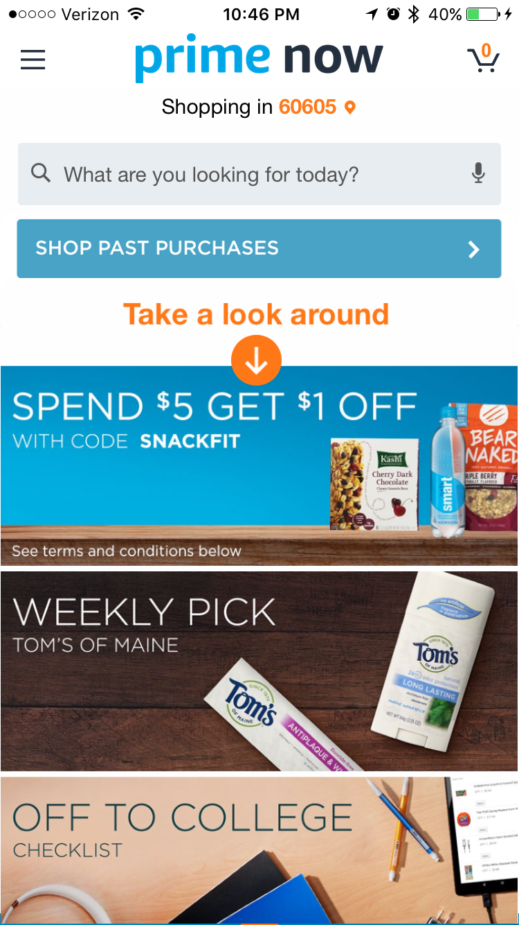
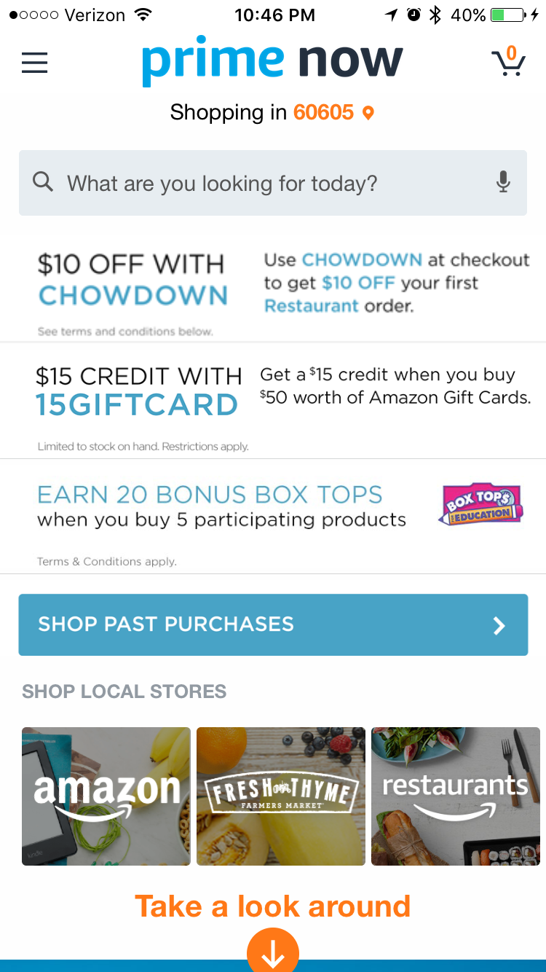
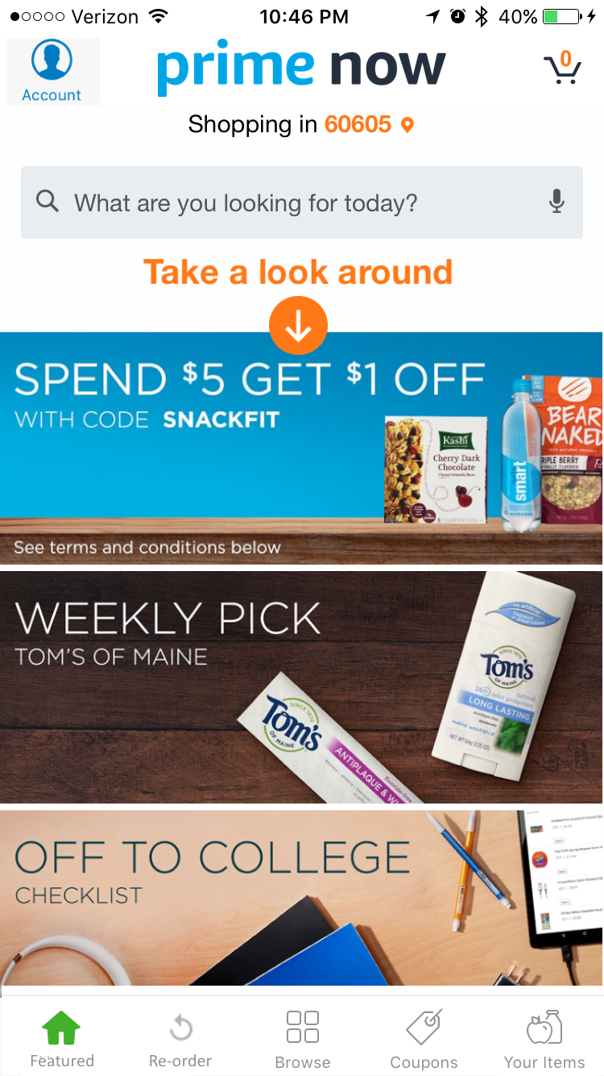
The Homepage Critical CTAs lack visibility
The Homepage's Calls-To-Action (CTAs) compete for attention. This increases the cognitive workload for users to decide what they want to interact with, even if they have a task in mind. This layout crowds out critical CTAs which lowers cognitive visibility.
Users may perceive CTAs as less visible as they keyhole their way into decision paralysis. Research shows that increases in choices reduces the satisfaction and visibility of potential choices.
A Semi-Structured User Interview could help understand expectations. Data analysis of existing App Analytics could show the first five interactions of the app, which would indicate the user’s information sent.
9 Actionable Items (3 Promotions, 3 Stores, Past Purchases, “Take a look…”, & Search)
5 Actionable Items in view, makes critical CTAs more visible.
Notes:
Research Questons:
What are the 5 most frequent user expectations when first opening the app?
What is the first thing users want to do when deciding to shop Prime Now?
The first visceral reaction to a site’s design influence how users perceive relevance, credibility, and even usability. By incorporating this knowledge throughout the design process, designers can make more effective products.

Slide 3
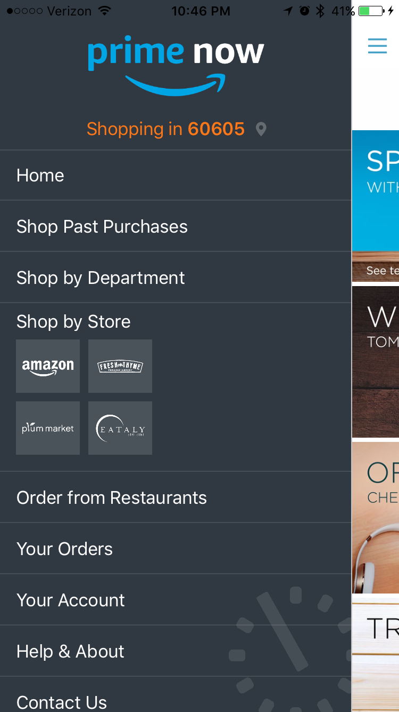
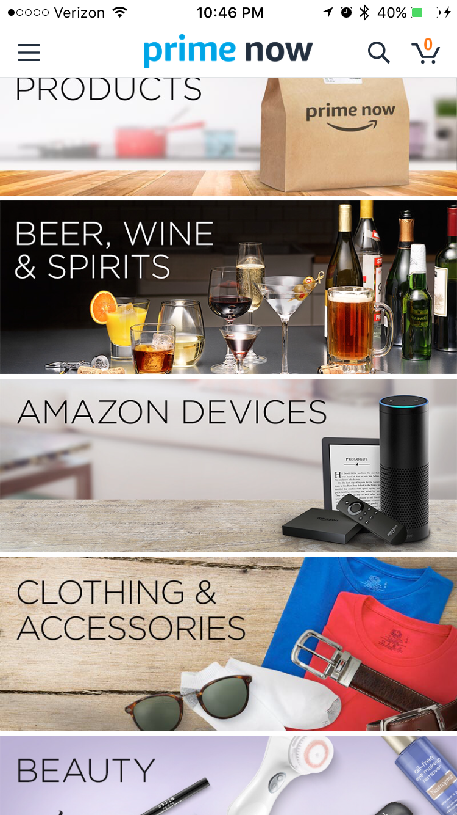
The Menu The Navigation is in the "Basement" and Exploration is out of mind.
The Menu Items cannot be seen unless the menu is clicked, however, their functionality may be used in every scenario. When the entire experience is not transparent, I.e. functions are out of sight of mind, users require higher cognitive workloads to imagine all the possibilities within the app.
Users may never realize the potential of the app or forget valuable functionality. Shopping past purchases, or browsing departments could be within every user story, but not if one forgets that they have this privilege.
Card Sorting Exercises could offer IA insights, while existing analytics could be used to find causal associations between user groups, menu usage, and conversions.
The menu hides critical tasks and nav. items which could all be used in every shopping experience.
The bottom app bar is always visible and available with a one touch solution to navigation.
Notes:
Analysis of menu usage, e.g. number of times menu is opened over the course of a session across different user groups (frequent, first time, and power users). See if menu usage qualities or frequency is associated with desirable customer characteristic

Slide 4
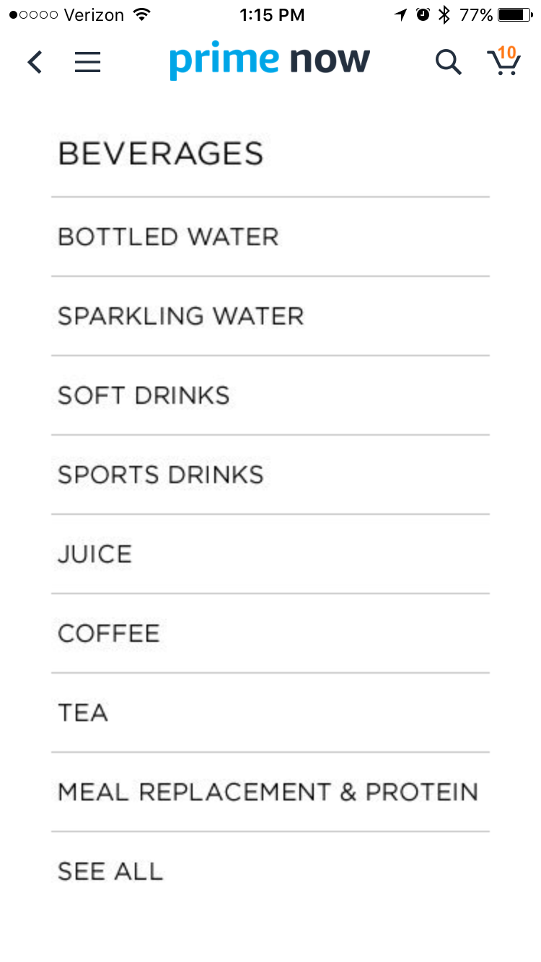
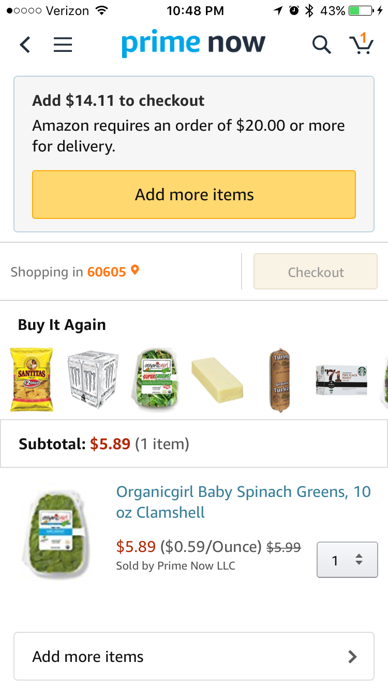
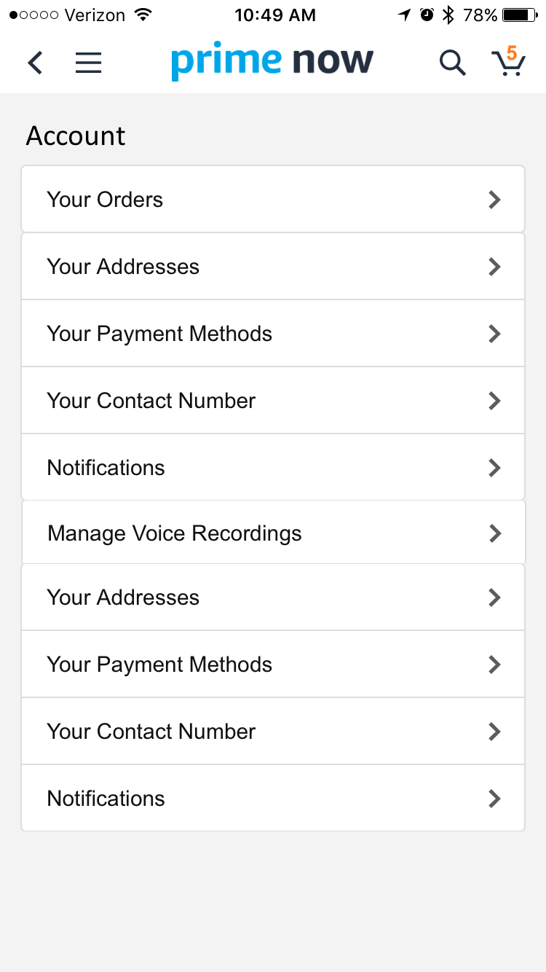
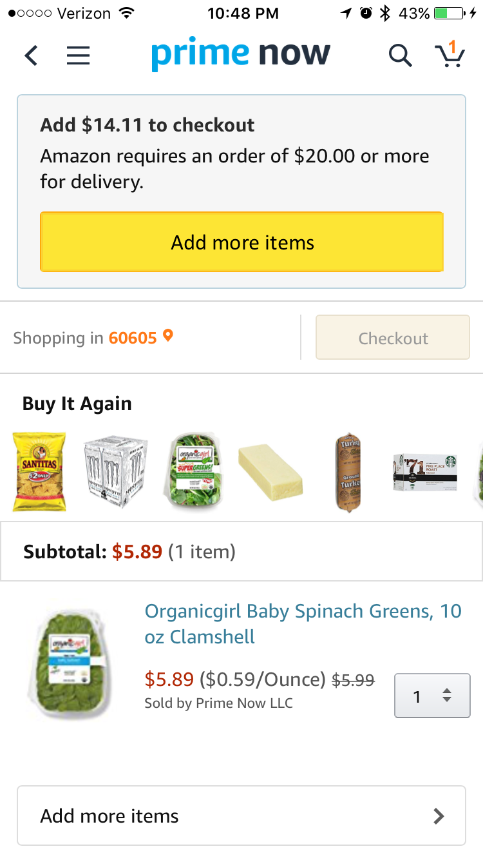
Actionable Items Components with similar functionality lack consistency and visual affordance
Coupons, CTAs and Menu list items have low visual affordance and lack consistency across similar functions.
Most users expect these things to be clickable, however, the display counteracts their intuition which causes a moment of self doubt. This 1-2 second delay could result in millions of less conversions.
While much HCI literature exists on the merits of visual affordance, A/B Usability Testing for these scenarios could help us understand how differences in time-on-task varies across different levels of visual affordance, and how time is associated with less conversions.
Action items blend in, look uninviting, and lack consistency between similar functions.
Action items with increased z-space, high resolution graphics and saturated colors relative to surrounding design elements.

Slide 5
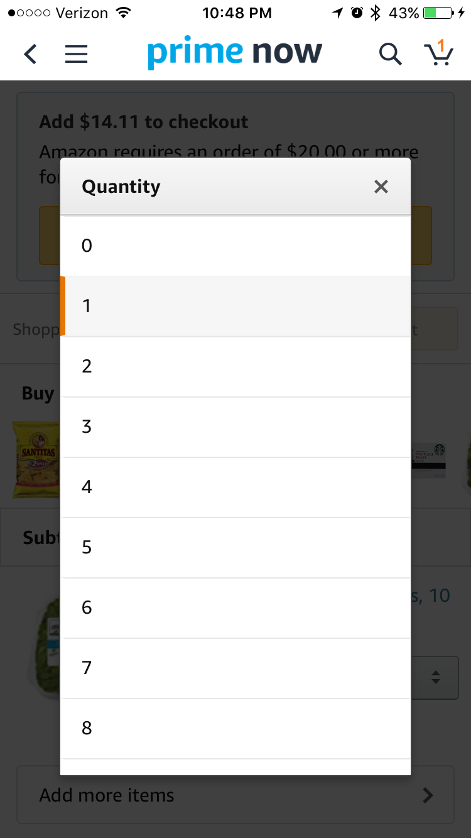
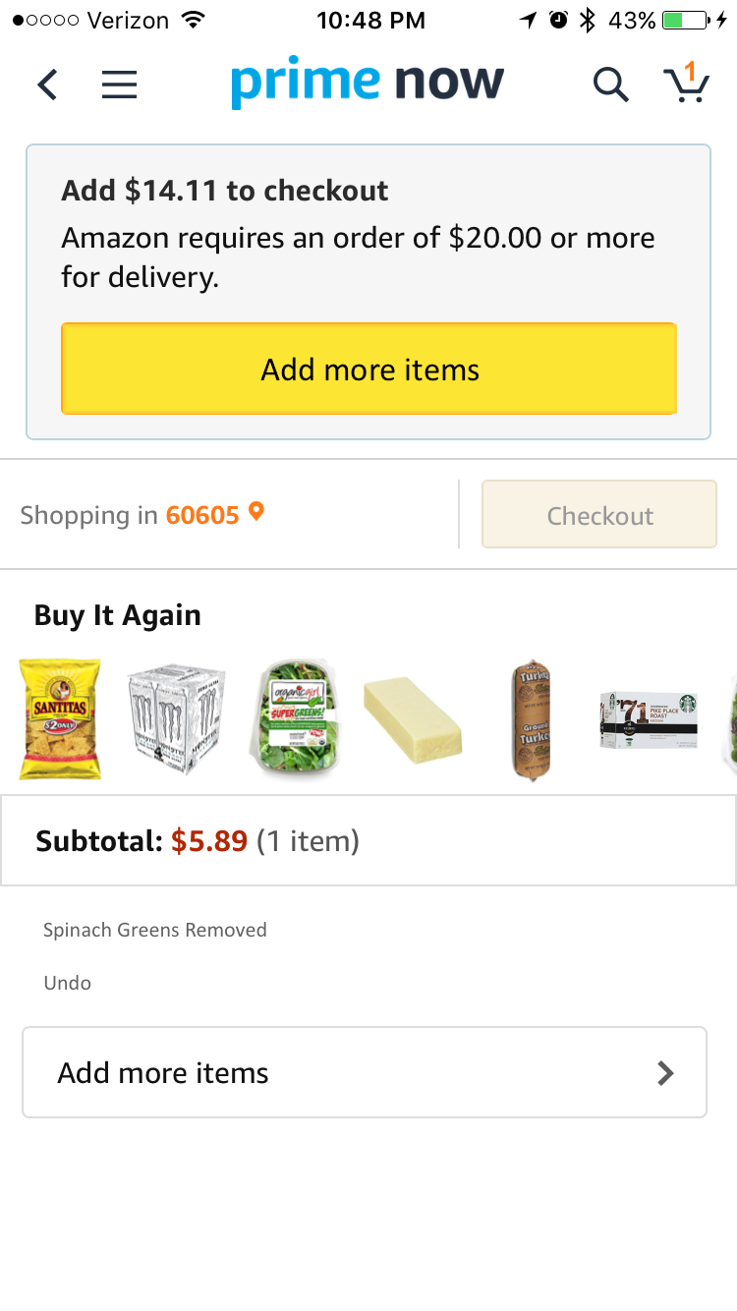
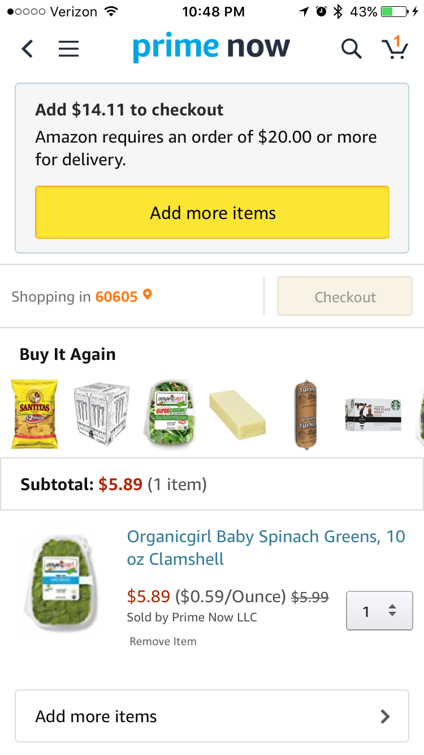
The Shopping Cart Error Prevention and Recovery
While reviewing the shopping cart, there is no option to remove items. One can only use the quantity drop-down component and select "0" which exhibits a visibility constraint since there is no way to tell that "0" would be a quantity without interacting with the drop down.
Users may not realize this sole option. Even if they do, this interaction requires many more interactions than a "remove" button. This decreases user control and freedom. They may abandon the shopping experience or require call center assistance if users cannot see how to prevent or recover mistakes.
A Usability Test for this task could answer questions such as: Do users know how to remove an item? How do users expect to remove items?
Unnecessary and hidden steps for each recovery interaction.
A visible one-touch "remove" button offers error recovery and sense of control.

Slide 6
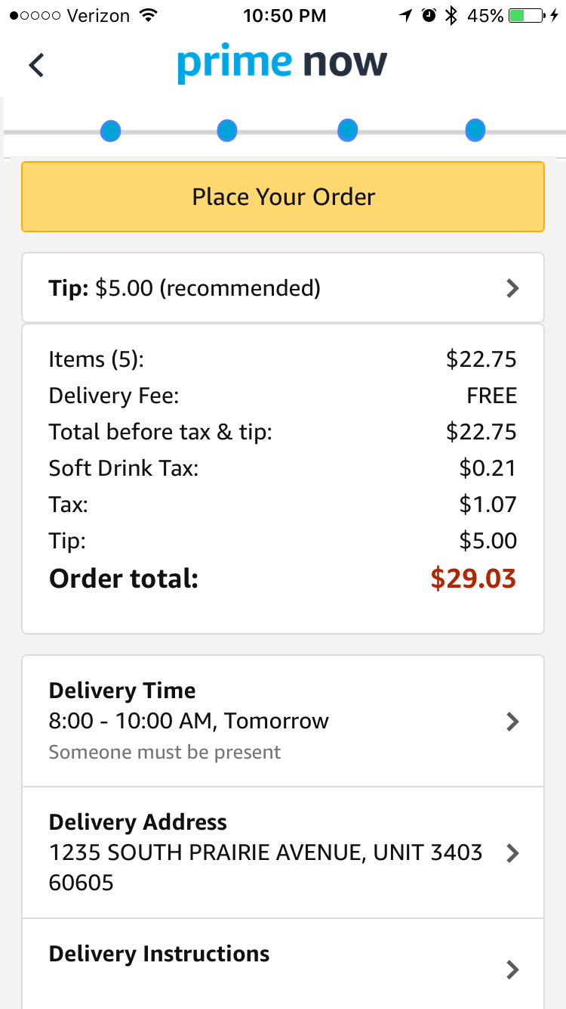
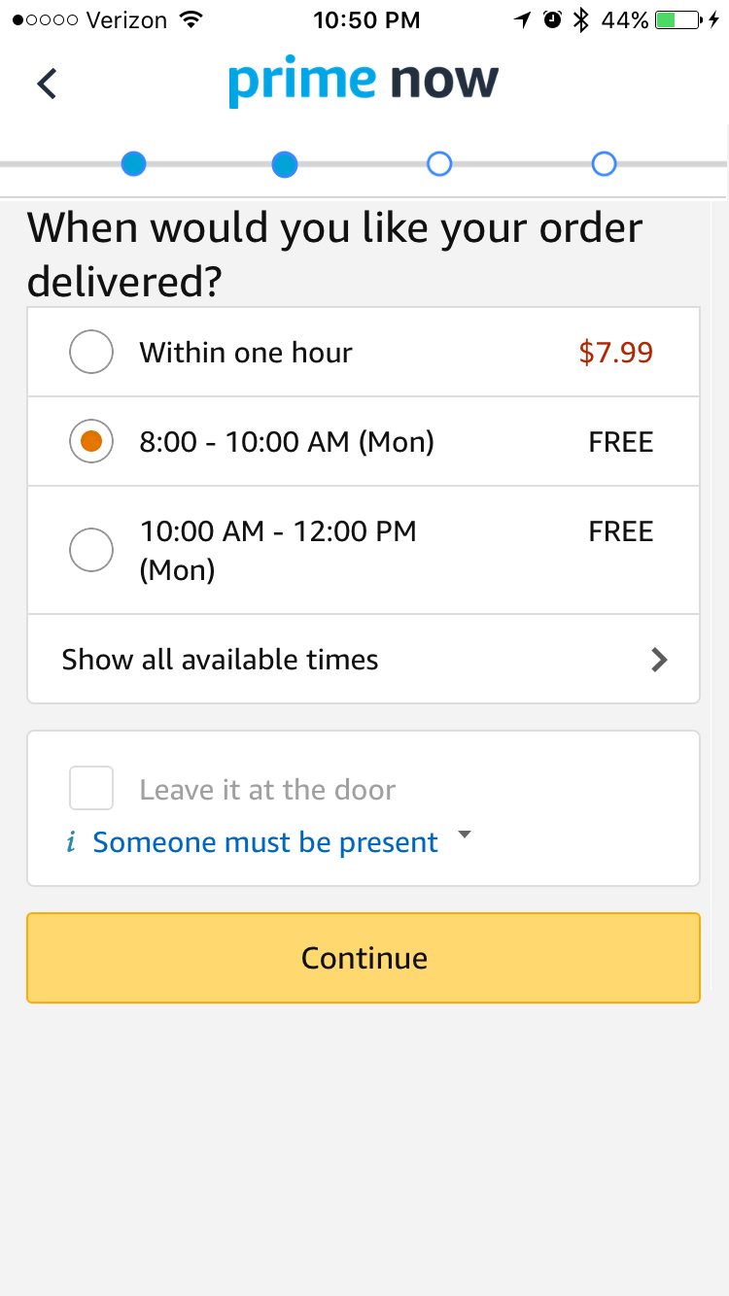
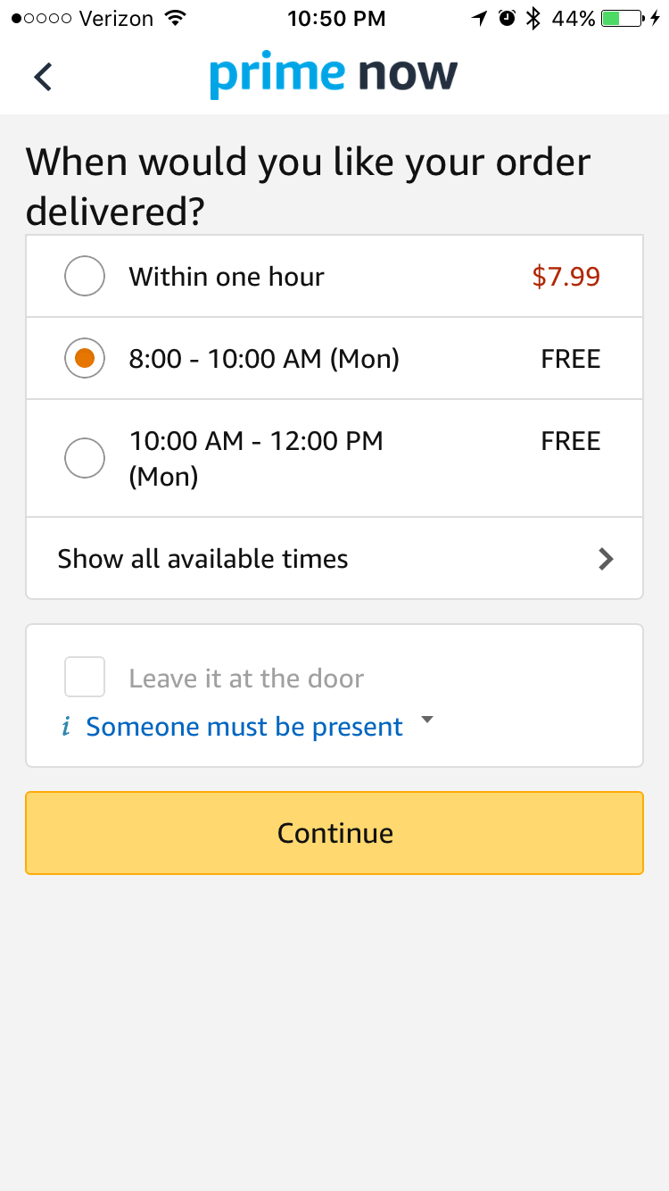
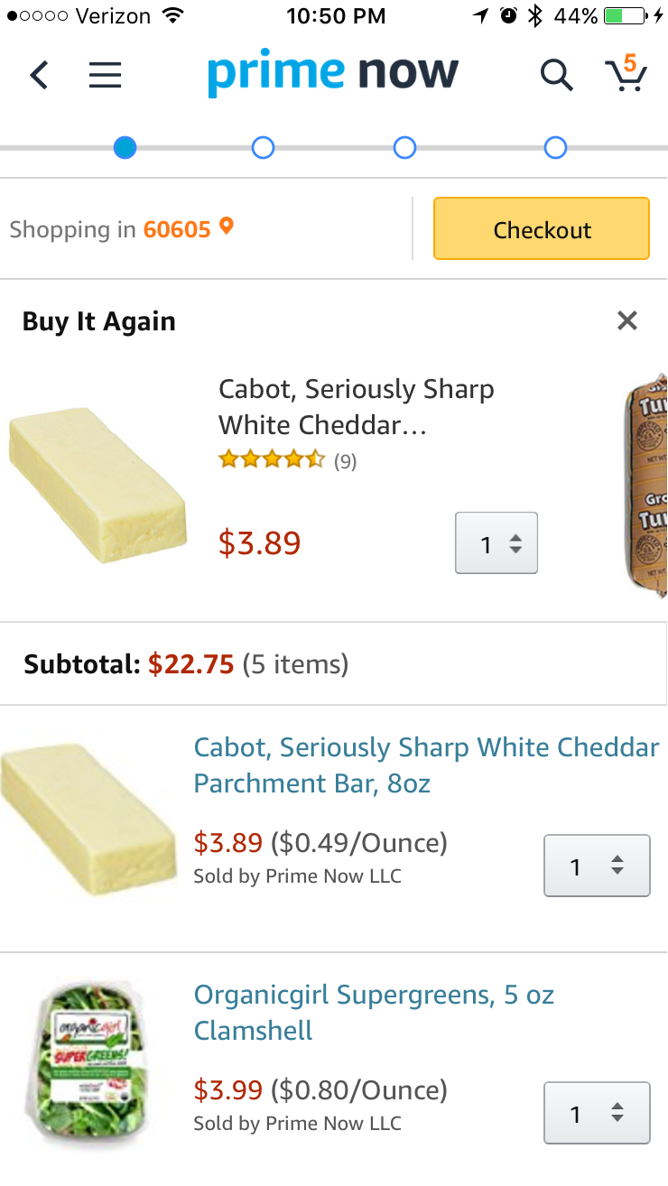
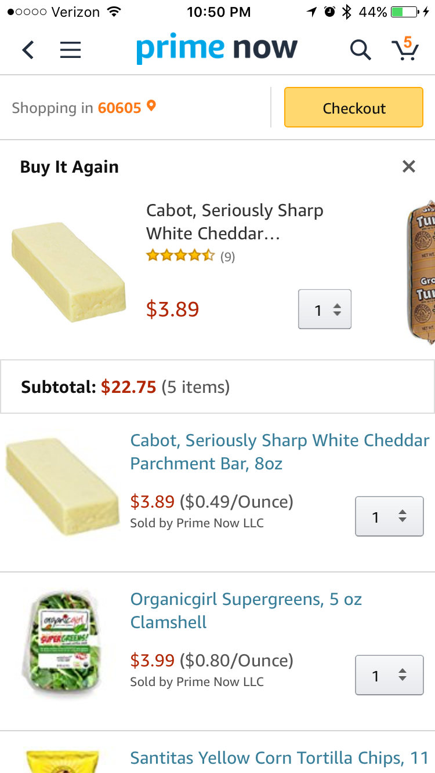
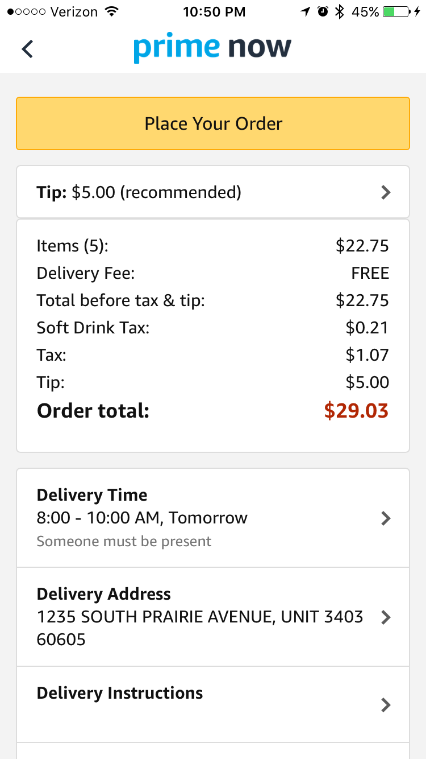
The Checkout Funnel Are we there yet?
During the Checkout process users are left with little to no feedback about where they are in the system. Each step to check out requires users to assume that waiting for the next page will tell them if there are more steps, or if they have competed the final step.
Users may not assume that more steps are required. They may step away from the process thinking that it is completed, or become frustrated with unanticipated steps.
App analytics could show whether or not users leave the funnel before “Placing an order” or if users cancel an order immediately after placing it. Usability tests could incorporate a ”pause” moment where moderators could ask users where they think they are in the process or what they think the button text means.
Users must understand English connotations in order to infer where they are in the process.
A progress meter with nodes tells users when they'll complete the process.

Slide 7
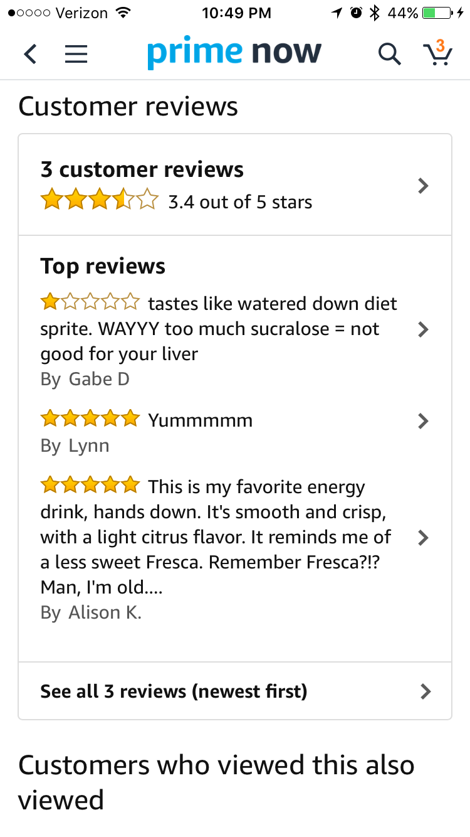
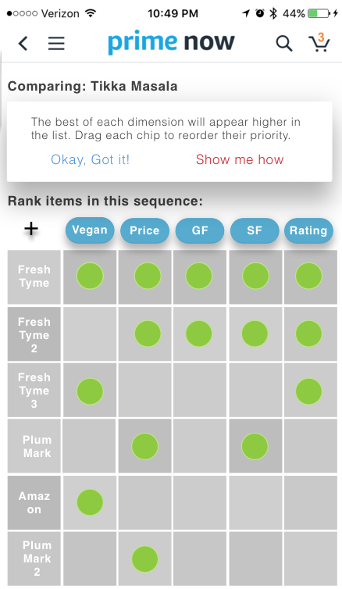
Comparing Products Missed opportunities
In order to compare products users have to switch back and forth between product views and remember which elements and measurements of the previous product need to be compared to the one in view.
Not only is this product mentally taxing and prone to error, but users will simply not enjoy doing this process.
A/B Usability Testing could shed light on which comparison tool works best. Comparison Tools with a progressive reduction process is popular suggestion and therefore more research should explore advantages and disadvantages. Additionally, a semi-structured interview with paper products should uncover users natural comparison processes for grocery items.
Users must memorize key qualities differences and navigate between product pages in order to compare.
A product comparison tool without a progressive reduction process makes the analysis more robust.

Slide 8
Recruiting, Activities & Outputs
CX data analysis on user behavior from Customer Service Data or Google Analytics:
Regression analysis between user session time, high frequency interactions, and key conversions
Analysis of menu usage, e.g. number of times menu is opened over the course of a session across different user groups (frequent, first time, and power users).
See if menu usage qualities or frequency is associated with desirable customer characteristic
Determine which, if any pattern of interactions are associated with desirable customer qualities
e.g. Do frequent user groups observe more or less product comparison interactions?
Recruit 35 for each 1.5 hr testing session (estimated tasks: 7, minimum: 5 participants per task)
Activities during testing:
A/B Task Based Usability Testing for Current and New Design Iteration
Semi-structured interviewing for pre-task: expectations, sentiments, environment inquiries
Post task: comprehension, other mental models, suggestions and use error root cause analysis
Card sorting exercise for IA insights regarding bottom navigation app bar

Slide 9
Future research on innovative extensions for pre-populating Shopping Carts
Share a Cart via text or social media (Recipe’s, Favorites Items, etc.)
Fitness Carts that receive data from apps with food journals, activity tracking, and biometric data (age, height, weight, macro goals)
Party carts that receive data from apps with event data: number of people, occasion, and time of day
USFG Food Cart based on food expenditure formulas that model family size, ages, and price sensitivity (How much a family should spend to eat healthy diet.)

